Slide 1
WELCOME TO Sicily
Paul Clark, Ryan Moore, Seth Rabinowitz, and Owen Williamson

Slide 2
Mission Statement
As a residential investment firm, we are looking to optimize our ability to identify future properties that will increase our company’s net income. In order to limit losses related to “unsuccessful” rental properties and identify qualitative attributes of a successful property, we will analyze existing rental properties to understand what characteristics are responsible for their success or failure.

Slide 3
Want to buy an Airbnb?
01
Overview of Airbnbs in Sicily
02
Analysis
03
How much money we will make
04
Conclusion
Number of listings, average price, occupancy
Optimal neighborhood to buy, type of listing, priorities of guests, and pricing
Listing price versus daily revenue
How to have the most successful listing

Slide 4
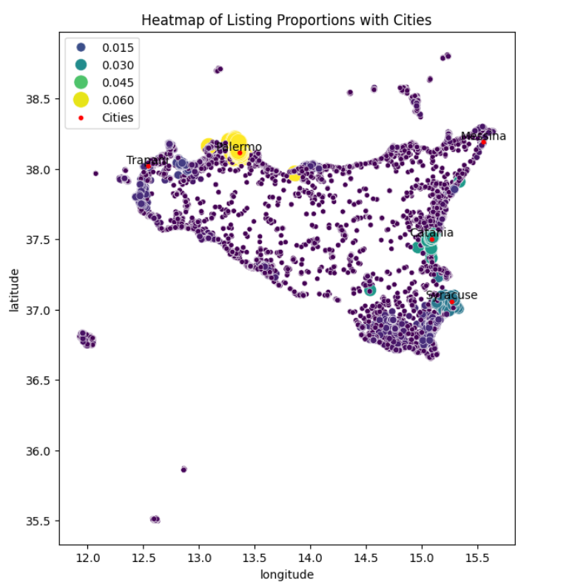
Current Airbnbs in Sicily
57963 listings in Sicily
  Palermo leads with over 3600 Airbnbs
  Catania has nearly 2000
  Siracusa has just under 1500
  These three cities and their directly adjacent neighborhoods account for 11,783 Airbnbs—20% of those in Sicily
The average price for a listing was $305 per night.

Slide 5
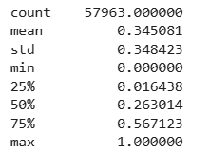
What is a ‘Successful’ Airbnb?
We define a ‘Successful’ listing as a listing having above 70% occupancy rate throughout the year. This benchmark represents one standard deviation above the average rate for all listings in Sicily.

Slide 6
What Features Impact Price and Occupancy Rate?
Property Type
Neighborhood
Bathroom Type
Property Type
Neighborhood
Bathroom Type
Occupancy Rate Variables:
01
02
03
The type of property was identified as statistically significant for Occupancy Rates.
The Neighborhood the rental properties are located in has a material impact on occupancy.
Listings with specific types of bathroom accommodations (private, 1-bath) are more frequently occupied..
Price Variables:
04
05
06
There are property types that both increase and decrease prices.
There are neighborhoods that command a higher price.
Guests are willing to pay a premium for certain accommodations.

Slide 7
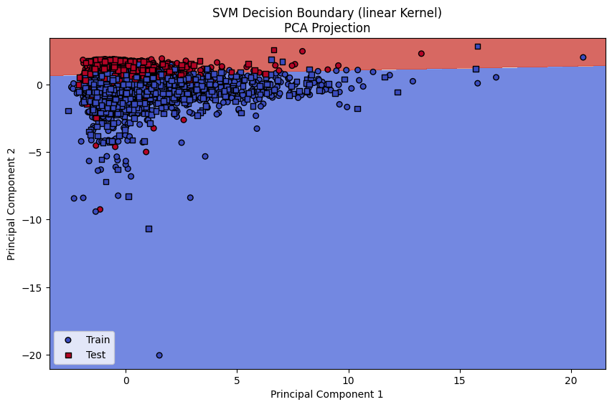
What Most Determines Success of an Airbnb?
Occupancy Rate
price: High prices may reduce bookings unless value is clear
bedrooms & accommodates: Bigger spaces attract more guests or higher-paying groups
bathrooms: More bathrooms → more comfort → better appeal
Review scores rating: Higher ratings = more trust = more bookings
Minimum nights: Longer stays may reduce booking flexibility
Notes:
Correlation:
Occupancy 0.86
Accommodates 0.05
Accuracy:
99%
Running with and without occupancy rate:
Without = rbf kernel 86% accuracy
With = linear kernel 99% accuracy

Slide 8
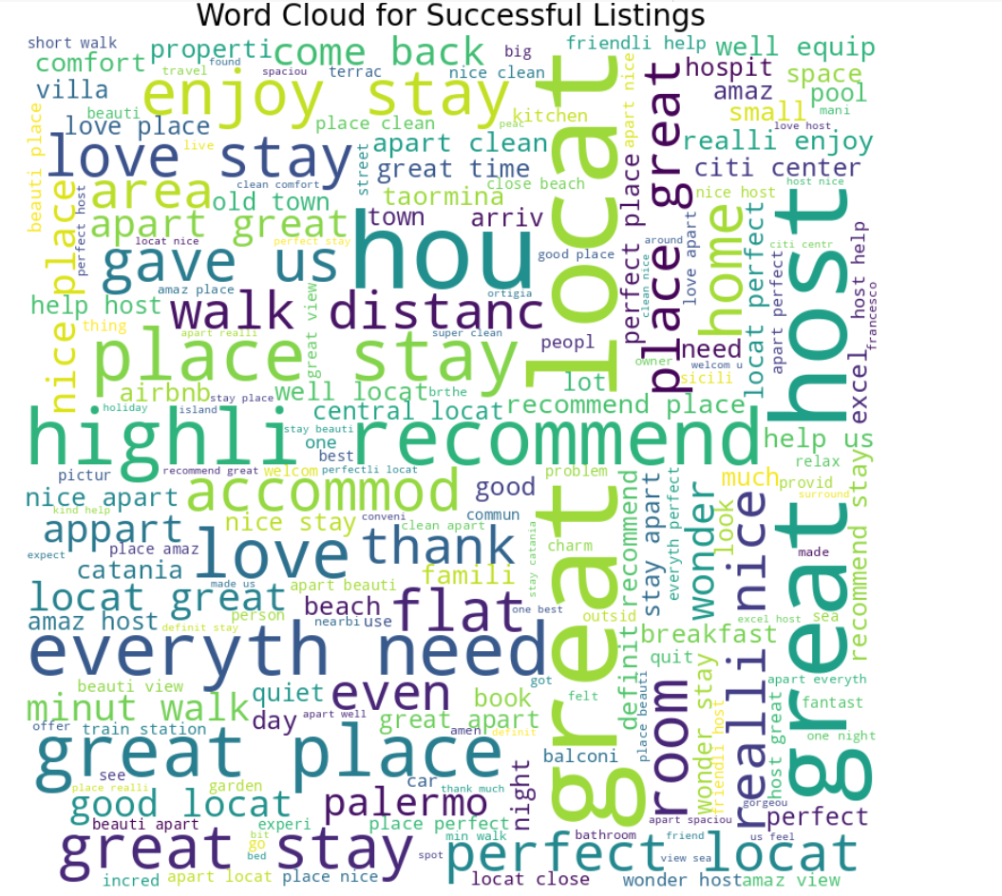
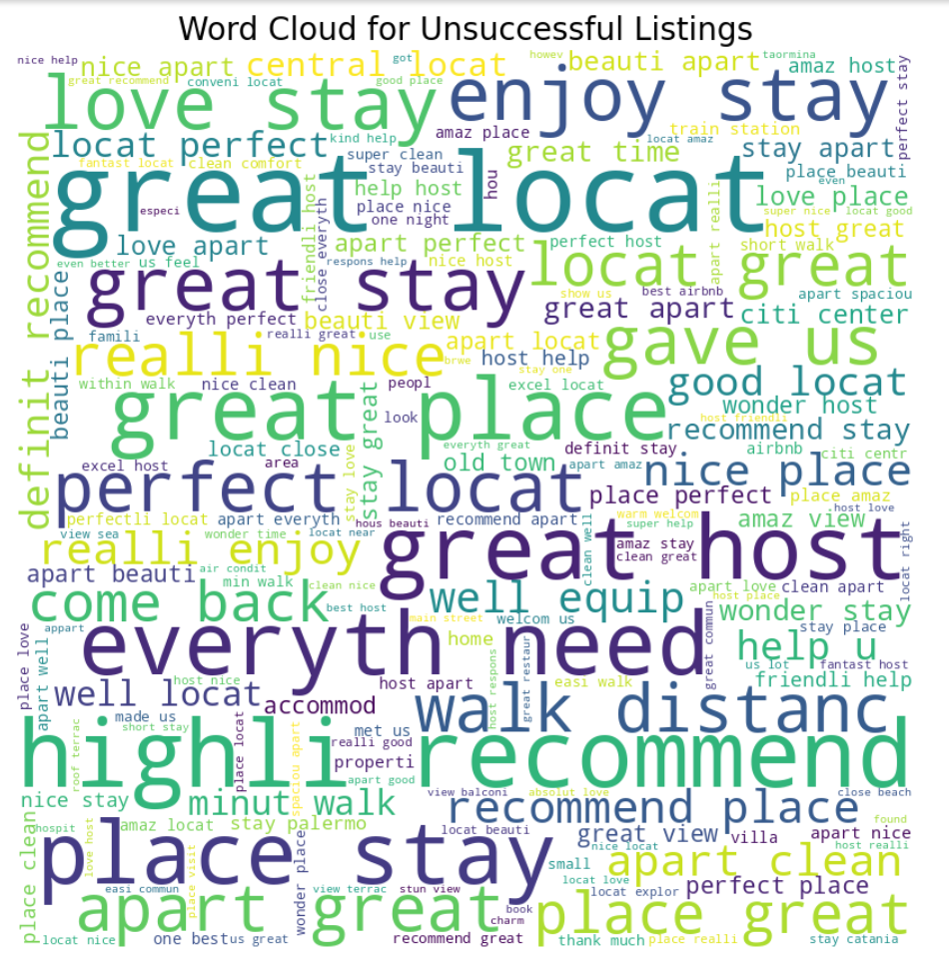
Guest Sentiment
After preprocessing review text, successful and unsuccessful listings highlight one key feature of Airbnbs in Sicily: great location within walking distance to the sea, restaurants, and city center.

Slide 9
STRATEGY
Standard Investments
Private Room/ Private Bathroom
Location
Private Room Properties
Private Bathroom Properties
Siracusa Properties
Great Location
Research and locate properties with a private room.
Research and locate properties with a private bathroom.
Research Siracusa properties. They tend to have a higher occupancy rate.
Airbnb guests prioritize a great location near the sea, restaurants, and city center.

Slide 10
Revenue Excellence: Successful Listings Occupancy-Weighted Revenue
The data reveals a significant disparity in occupancy-weighted revenue between successful and unsuccessful listings. This significant difference highlights how successful listings excel in generating higher revenue through improved occupancy rates.

Slide 11
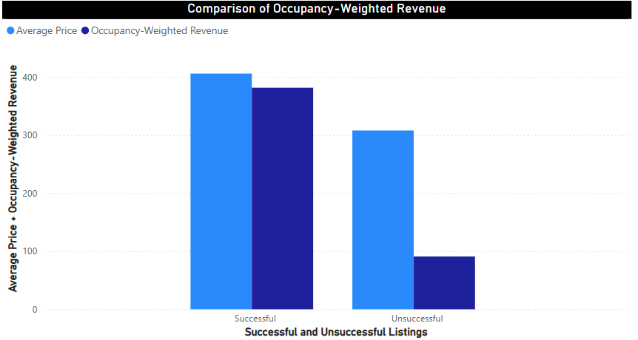
Achieving Revenue through a Higher Occupancy-Rate
Successful Occupancy-Weighted Revenue: $381.37
Unsuccessful Occupancy-Weighted Revenue: $90.85
Occupancy-weighted revenue combines both price and occupancy rate to provide a more holistic view of its revenue generation potential.

Slide 12
Conclusion
While these findings will not guarantee a successful listing, these strategies will give a strong chance of standing out in the saturated Airbnb market in Sicily.
Pricing must be competitive and fair
Location, such as neighborhoods and central locations, have a significant impact on both occupancy and price and are important to guests based on reviews
Property types, particularly private room, increase occupancy rates
Listings with a private bathroom are both more expensive but also have less availability, meaning more booked up

Slide 13
Thank you

